Slide 1

Scribble to Digital
An AI-powered system that converts handwritten notes into clean, structured digital text with automatic task extraction

Slide 2
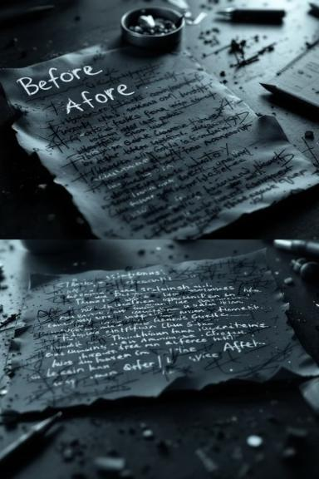
Transforming Handwritten Chaos into Digital Clarity
The Challenge
Our Solution
Students and professionals face daily productivity hurdles when digitising handwritten notes. Poor lighting, unclear handwriting, and mixed content reduce efficiency and demand time-consuming manual rewriting.
AI-powered conversion that enhances images, extracts text via OCR, and applies Generative AI to correct grammar whilst automatically extracting actionable tasks. Built with Streamlit and Python.

Slide 3



Three Core Capabilities
Image Enhancement
Intelligent Correction
Task Extraction
OpenCV processes uploaded images by converting to grayscale, adjusting brightness and contrast, reducing noise, and applying thresholding for optimal OCR accuracy.
Generative AI analyses extracted text to correct spelling, improve grammar, reconstruct incomplete words using contextual understanding, and format into readable paragraphs.
AI identifies task-oriented statements, extracts actionable items, and organises them into structured bullet-point to-do lists for improved productivity.

Slide 4




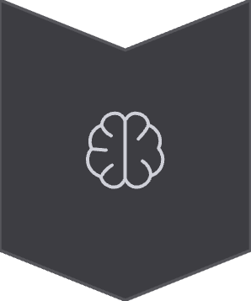
System Architecture
Streamlit Frontend
User interface for image uploads and result display
OpenCV Processing
Image enhancement and preprocessing
OCR Engine
Tesseract/EasyOCR text extraction
Gemini 2.5 Flash
AI contextual correction and task extraction

Slide 5
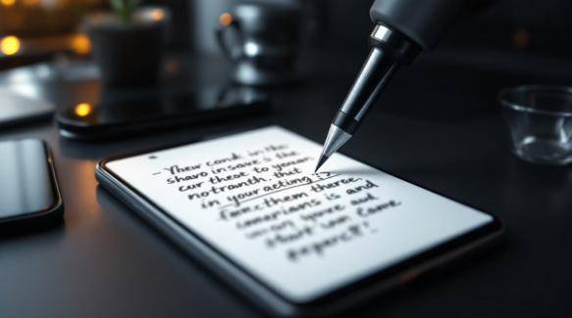
Image Enhancement Process
Processing Pipeline
Image upload via Streamlit interface
Grayscale conversion for consistency
Brightness and contrast adjustment
Noise reduction filters applied
Adaptive thresholding techniques
Enhanced image passed to OCR
This preprocessing ensures better readability and higher text recognition accuracy even for low-quality or unclear handwriting, significantly improving OCR performance.

Slide 6




Architecture Overview
Frontend Layer
Streamlit interface accepts image uploads and displays processed results with enhanced previews
Processing Layer
OpenCV enhances images whilst OCR extracts raw text from processed handwriting
AI Layer
Gemini corrects grammar, reconstructs words, formats paragraphs, and extracts tasks
Export Layer
ReportLab and Python-DOCX generate PDF and Word documents for download

Slide 7
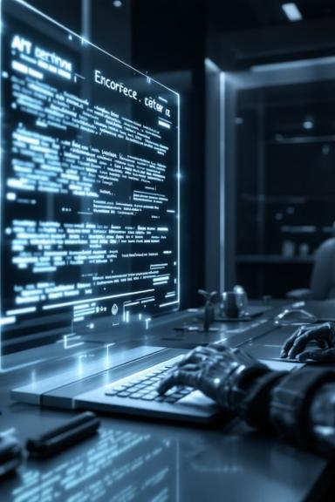
AI-Powered Text Correction
01
Error Detection
Identifies spelling mistakes, missing letters, and broken words from handwriting variations
02
Contextual Analysis
Uses semantic understanding to reconstruct incomplete or unclear words accurately
03
Grammar Correction
Improves sentence structure and punctuation for professional readability
04
Formatting
Organises content into structured paragraphs with proper flow

Slide 8

Automatic Task Extraction
How It Works
The AI system analyses sentence intent to detect task-oriented statements and extract actionable items automatically.
Key Features
Distinguishes tasks from general notes
Organises into structured bullet-point lists
Identifies action verbs and keywords
Separates information from action items

Slide 9

Implementation Process
1
AI Setup
Configure Gemini API keys, validate connectivity, and design prompt templates for correction and task extraction
2
Core Development
Build Streamlit structure, implement image processing with OpenCV, and integrate OCR text extraction
3
UI Design
Create interactive components, display structured results, and add export functionality
4
Testing
Validate accuracy across handwriting qualities, optimise performance, and handle edge cases gracefully

Slide 10
Testing Results
1
2
3
Clear Handwriting
Medium Quality
Poor Quality
Accurate OCR extraction with proper grammar correction. Tasks correctly identified and formatted into to-do lists.
OCR extracts readable text with AI contextual correction improving clarity. Most tasks properly separated.
Image enhancement improves visibility. AI generates partially corrected readable text with partial extraction.
The system handles various handwriting qualities effectively, with image enhancement and contextual AI logic compensating for lower input quality.

Slide 11

Technology Stack
Streamlit
Gemini 2.5 Flash
Interactive web application framework for UI, file uploads, and dynamic result display with modular architecture
Fast multimodal AI model for contextual understanding, grammar correction, and intelligent task extraction
OpenCV
Tesseract/EasyOCR
Image preprocessing including grayscale conversion, noise removal, and adaptive thresholding techniques
Handwriting recognition engines that convert enhanced images into machine-readable text
Python 3.8+
Export Modules
Core programming language with python-dotenv for environment management and configuration
ReportLab and python-docx for generating downloadable PDF and Word document formats

Slide 12
Optimisation Highlights
Performance Improvements
Error Handling
User Experience
Graceful handling of blank images and OCR failures
User-friendly messages for API and connectivity issues
Prevents automatic reprocessing on page refresh
Loading spinner provides feedback during processing
Checkbox to show/hide raw OCR comparison
Stable performance under continuous usage
Optimised image preprocessing reduces processing time
Improved prompt structure reduces API response length
Input validation prevents invalid file processing

Slide 13
Development Milestones
Milestone 1
1
Gemini AI setup with API key configuration, environment variables, and prompt design for note processing
2
Milestone 2
Core Streamlit implementation with OCR processing module, image enhancement, and AI correction integration
Milestone 3
3
Flask backend development with complete route definitions, error handling, logging, and JSON responses
4
Milestone 4
Modern UI with responsive design, multi-page navigation, export functionality, and user feedback systems
Milestone 5
5
Comprehensive testing with quality evaluation, performance optimisation, and edge case handling

Slide 14

Real Results, Measurable Impact
Accuracy Improvements
Productivity Gains
Image preprocessing combined with contextual AI correction significantly enhances OCR accuracy, even for poor-quality handwriting with shadows or low brightness.
Automatic task extraction eliminates manual identification of action items, saving users time whilst ensuring no tasks are overlooked in their notes.
Scribble to Digital bridges the gap between handwritten creativity and digital productivity, transforming messy notes into clean text and structured task lists. Whether for students, professionals, or teams, the application serves as an intelligent assistant that enhances organisation, improves clarity, and streamlines everyday workflows.

Slide 15




Transform Your Workflow
Scribble to Digital bridges handwritten creativity with digital productivity. By combining OCR technology with advanced generative AI, the system accurately extracts handwritten content, enhances readability through contextual correction, and intelligently identifies actionable tasks.
Students
Professionals
Convert lecture notes instantly
Digitise meeting minutes
Teams
Share structured content
Save time and effort whilst improving organisation and clarity across everyday workflows.

